Slide 1
Eldercare AI
A safe multi-agent coordination prototype for care workflows

Slide 2

Introduction
This proof-of-concept web app demonstrates how AI agents coordinate multimodal care events into a shared patient state and produce role-tailored proposals subject to mandatory safety review.
The demo highlights safety-first coordination, consent-aware delivery, and auditable decision trails for non-technical judges.

Slide 3

01
Problem Statement

Slide 4

Fragmented sources
Care data arrives from devices, clinicians, caregivers, and patients in varied formats and timing.
Without normalization into a single shared state, critical signals are missed and coordination fails.

Slide 5
Stakeholder divergence
Different actors require distinct detail, tone, and access: patients, caregivers, clinicians, and reviewers.
The platform must enforce role-specific outputs and consent-aware sharing to maintain clarity and privacy.

Slide 6
Safety gaps
Automated outputs risk harm if unchecked: incorrect advice, inappropriate tone, or privacy breaches.
A centralized review and immutable proposal versions build accountability and reduce clinical risk.

Slide 7

02
System Solution

Slide 8
Multi-agent orchestration
Specialized agents ingest events, update the shared state, and generate role-specific proposals with surfaced uncertainty and rationale.
Agents are modular, auditable, and designed for safe escalation.

Slide 9
Centralized safety review
Every proposal passes a mandatory safety check for risk, consent, tone, and recipient fit.
The review can auto-correct, reject-and-regenerate, escalate to clinicians, or route to human reviewers per policy.

Slide 10

Consent-aware delivery
Outputs are tailored by role with consent-aware access controls and tone adaptation.
A complete audit trail and immutable proposal versions ensure privacy and accountability across recipients.

Slide 11
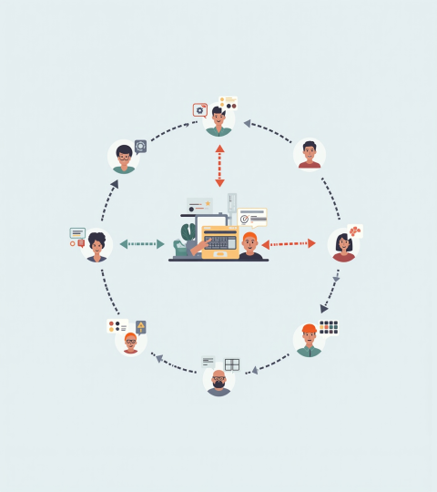
02
Workflow

Slide 12
Event ingestion
Multimodal inputs (devices, clinician notes, caregiver messages) are normalized into a common format.
This enables timely detection of care events and consistent downstream processing.

Slide 13
Shared patient state
A single canonical patient state aggregates events, medications, and care history.
Agents read/write this state to maintain coherence and reduce conflicting recommendations.

Slide 14

Proposal lifecycle
Specialized agents generate role-specific proposals which include uncertainty and rationale.
Each proposal undergoes mandatory review, then is delivered, revised, escalated, or sent to human clinicians.

Slide 15

03
Proof-of-Concept

Slide 16
Demo scenarios
Scenarios include missed medication follow-up, caregiver task generation, clinician summary preview, and escalation flows.
Each scenario highlights safety checks, reject-and-regenerate behavior, and role-specific delivery.

Slide 17

Technical stack
FastAPI backend, React + Vite frontend, PostgreSQL database, with optional OpenAI integration for language tasks.
Modular services enable secure deployment and auditability.

Slide 18
Audit & governance
Immutable proposal versions, reviewer decisions, and escalation logs form a searchable audit trail.
Configurable policies allow governance teams to tune safety thresholds and reviewer routing.

Slide 19

Conclusions
This prototype demonstrates a safety-first approach: AI agents coordinate care through a shared state and mandatory centralized review.
It provides a practical, auditable path for deploying AI-supported eldercare in real-world settings.

Slide 20
THANKS!
Do you have any questions?
youremail@freepik.com
+91 620 421 838
yourcompany.com
Please keep this slide for attribution

